Slide 1
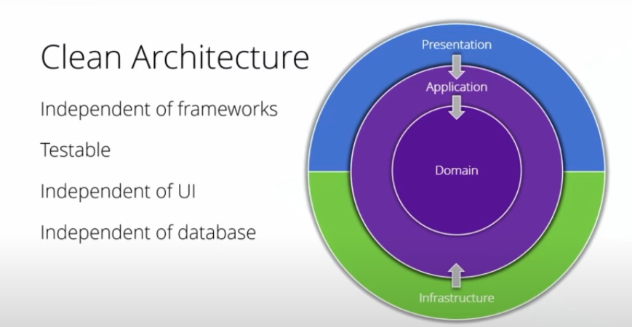
Presentation : Angular / Web Api / MVC
Application : Interfaces, CQRS Features, Exceptions
Domain : All the Entities and the most common models
Infrastructure : external source like Data source,email,smtp

Slide 2
Component
Clean Architecture / Onion Architecture / hexagonal Architecture
- CQRS with MediatR Library
- Entity Framework Core - Database First
- Repository Pattern - Generic
- Swagger UI
Microsoft Identity with JWT Authentication
- Role based Authorization
- Custom Exception Handling Middlewares
- API Versioning
- Fluent Validation
- Automapper
Caching

Slide 3
1. Core
The Core Layers will never depend on any other layer. Therefore what we do is that we create interfaces in the Application Layer and these interfaces get implemented in the external layers. This is also known and DIP or Dependency Inversion Principle.
It is also important to note that these layers are .NET Standard 2.1 Libraries. This is so because we need to make these layers as compatible as possible with other projects. Let’s say tommorow your client wants a .NET 4.7 Solutions (quite unlikely though) with the near-same business logics. At such scenarios, .NET Standard Libraries will be of great help.
1.1 Domain
All the Entities and the most common models are available here. Note that this Layer will NEVER depend on anything else.
1.2 Application
Interfaces, CQRS Features, Exceptions, Behaviors are available here.
2. Infrastructure
Whenever there is a requirement to communicate with an external source, we implement it on the Infrastructure Layer. For example, Database or other Services will be included here. To make the separation more visible, We will maintain further sub projects with the naming convention as ‘Infrastructure.xxxxxx’ where xxxxxx is the actual Point of Concern.
2.1 Infrastructure.Identity
In this implementation, we will make use of the already AWESOME Microsoft Identity. Let’s seperate the User Managment Database from the Main Application Database. This is made possible by multiple – DbContext Classes in each of the required Infrastructure Project
2.2 Infrastructure.Shared
Now, there are some services that are common to the other Infrastructure Layers and has the possibility of use in nearly all the Infrastructure Layers. This includes Mail Service, Date Time Service and so on. Thus it is a better Idea to have a shared Infrastructure project as well.
3. Presentation Layer
Web api / Angular / Asp.Net MVC
This is also known as the Presentation Layer, where you would put in the project that the user can interact with. In our case it is the WebAPI Project

